Slide 1
Programming Assessment:
Simple Expense Tracker Application
KUMAR TEJA CHITTA
December 7th ,2025

Slide 2
OUTLINE
Overview
Solution Approach
Key Folders and Files
Setup and Execution
Test and Verify
Application Demo

Slide 3
Overview
Simple Expense Tracker Application:
A Streamlit-based expense tracking application with a PostgreSQL backend for managing personal expenses with real-time visualizations and analytics.
Features
Add expenses with category, amount spent, and date
View total expenses across all categories
Category-wise expense breakdown with pie chart
Expense trends over time with line chart
Identify highest and lowest spending categories
Duplicate expense detection
PostgreSQL database for persistent storage
Clean and intuitive user interface

Slide 4
Solution Approach
Architecture:
3-Tier Design:
Presentation Layer (UI)
Application Layer (Logic)
Data Layer (Database)
Modular Components:
Separation of concerns
Independent modules for each functionality
Technology Stack:
Backend: Python
Database: PostgreSQL
Frontend: Streamlit
Visualization: Plotly
Design Principles:
Data validation at the entry point.
Duplicate prevention with DB constraints.
Real-time visualizations update
Error Handling at each layer
Secure credentials management (.env)

Slide 5
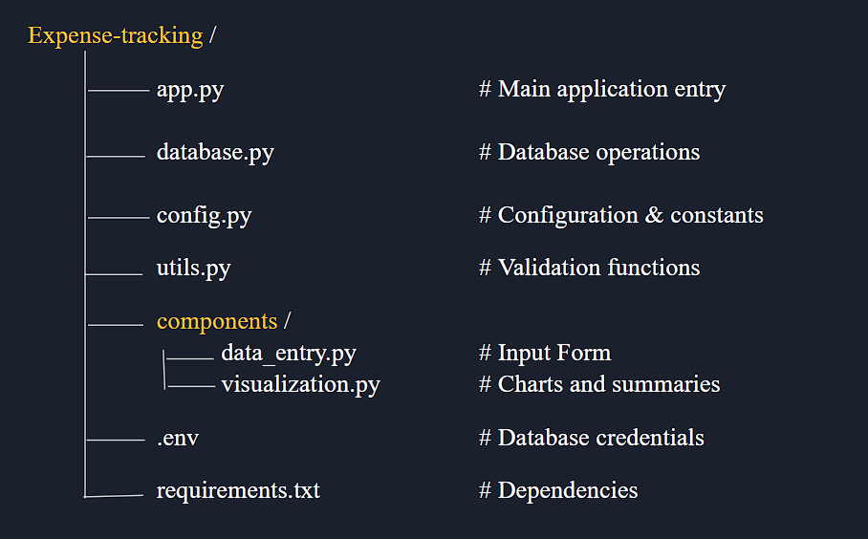
Key Folders and Files

Slide 6
Setup and Execution
Clone the Repository
- git clone (https://github.com/KumarTejaChitta/Expense_tracker.git)
- cd expense-tracker
# Windows PowerShell
- python -m venv .venv
- .\.venv\Scripts\Activate.ps1
# Windows Command Prompt
- python -m venv .venv
- .venv\Scripts\activate.bat
# Mac/Linux
- python -m venv .venv
- source .venv/bin/activate
# Install dependencies
- pip install -r requirements.txt
2. How to run locally
# Make sure virtual environment is activated
- (.venv) PS D:\expense-tracker>
#Run the application
- streamlit run app.py
- The application will open in your browser at http://localhost:8501
3. Set up PostgreSQL Database
- Create Database: expense-tracker
- Run the SQL script to create the table.
- Configure .env with credentials.

Slide 7
Test and Verify
Test Scenario:
Add expense → Success message
Duplicate entry → Warning message
Invalid date → Error message
Summary visualization → 4 charts display
Test data included:
15+ sample expenses across all categories
Multiple dates for trend analysis
Variety of amounts for meaningful charts
Testing Methods:
Manual functional testing of all features
Database integrity verification via pgAdmin
Edge case validation (boundaries, nulls)
Cross-browser compatibility testing

Slide 8
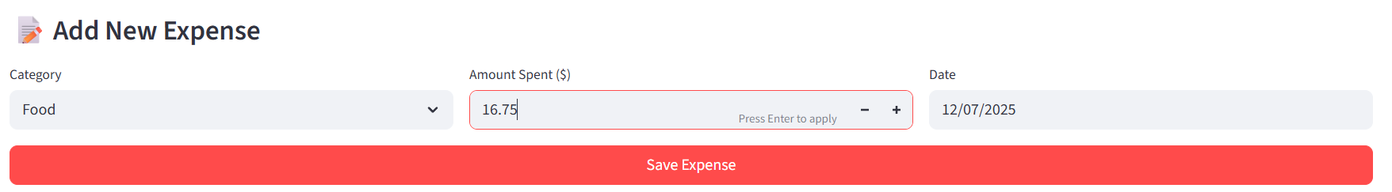
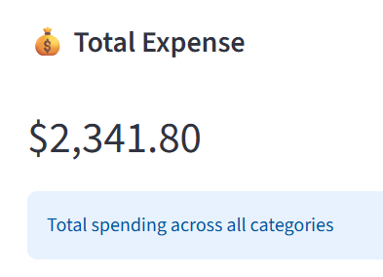
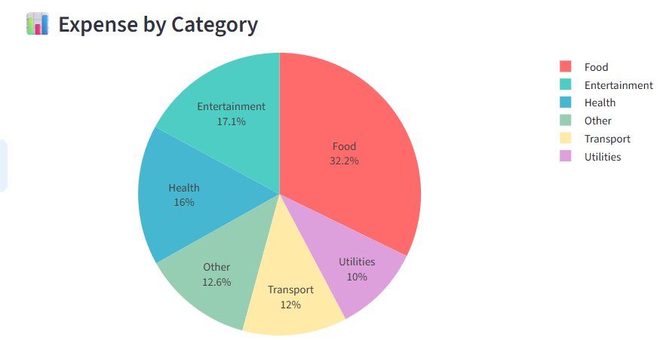
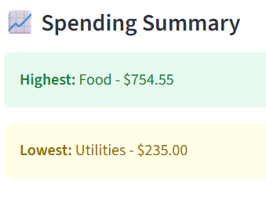
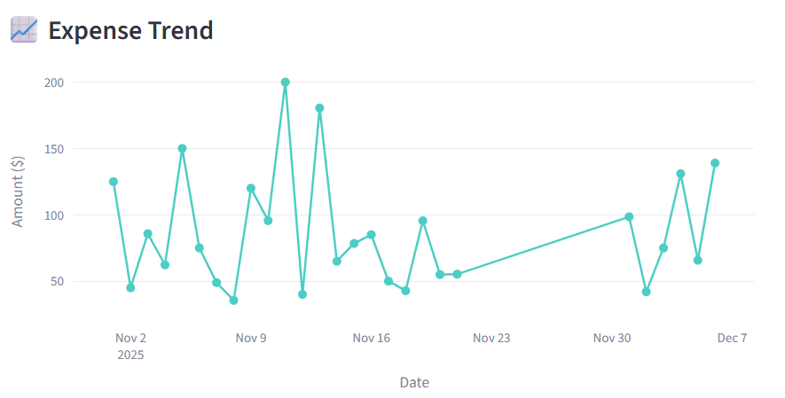
Application Demo

Slide 9
Thank you
Application GitHub link: https://github.com/KumarTejaChitta/Expense_tracker.git

